Slide 1
Advanced Software Engineering Course
Structural Design Patterns
Antonio Di Monaco
Computer Science Bachelor Program

Slide 2
Topics
Structural
  Introduction
  Adapter
  Bridge
  Façade
  Composite
  Decorator
  Flyweight
  Proxy
Reference: https://refactoring.guru/design-patterns

Slide 3
Introduction
Structural patterns defines how classes and objects are composed to form larger structures
That can happen in multiple ways
  Adapting interfaces (Adapter)
  Build a complex structure made up of primitive and composite objects, which composite are made of other primitive and composite objects (Composite)
  Sharing a relevant quantity of objects to reduce space and improve efficiency (Flyweight)
  Creating placeholders or surrogate for other objects (Proxy)
  Creating objects that represent an entire subsystem (Facade)
  Add responsibilities to objects dynamically (Decorator)
Key Principles:
Interface Adaptation
Making incompatible interfaces work together
Simplified Access
Providing easier ways to interact with complex systems

Slide 4
Adapter - Problem
In real software we constantly have to make components talk that were not designed to talk to each other:
a legacy module whose API cannot be changed (no source code, frozen contract, vendor lock-in)
a third-party library whose interface does not match our domain vocabulary
two independent subsystems developed in parallel with incompatible contracts.
The client code expects a certain interface — a set of operations with specific names, signatures and semantics.
The existing class offers different operations. Calling the existing class directly would force us to either (1) modify the legacy/third-party class (forbidden or risky), or (2) scatter if/else translation code across every client (unmaintainable).

Slide 5
Adapter - Usage
When to use it
you must integrate legacy or third-party code whose interface you cannot change
you want to reuse existing classes with incompatible interfaces
you want to keep clients decoupled from concrete implementations (the client sees only the Target)
you need a controlled "anti-corruption layer" between your domain and an external API
When to not use it
you control both sides — just change one of the interfaces directly (an adapter adds a class and an indirection for no benefit)
the two interfaces are nearly identical — a simple subclass or a few overloads suffice
performance is critical on a hot path and the extra delegation call matters (rare in practice)

Slide 6
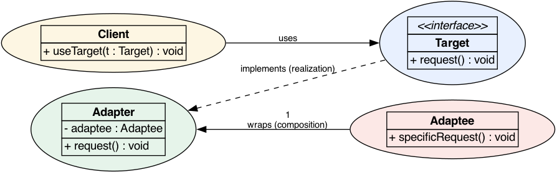
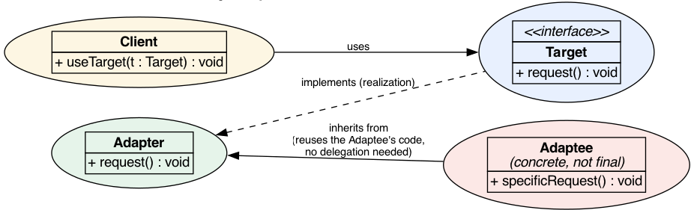
Adapter - Class diagram
Object Adapter
Class Adapter

Slide 7
Payment Processor - Adapter - Target and Adaptee
public class LegacyBillingSystem {
public String executeBilling(String customerCode, int amountInCents) {
System.out.println("[LEGACY] Billing customer: " + customerCode
+ " | Amount (cents): " + amountInCents);
// Simulates returning a transaction ID
return "TXN-" + System.currentTimeMillis();
}
public boolean reverseTransaction(String txnId, int amountInCents) {
System.out.println("[LEGACY] Reversing transaction: " + txnId
+ " | Amount (cents): " + amountInCents);
return true;
}
}
public interface PaymentProcessor {
void processPayment(String customerId, double amount);
boolean refundPayment(String transactionId, double amount);
}

Slide 8
Payment Processor - Adapter - Client
public class OrderService {
private final PaymentProcessor paymentProcessor;
public OrderService(PaymentProcessor paymentProcessor) {
this.paymentProcessor = paymentProcessor;
}
public void checkout(String customerId, double totalAmount) {
System.out.println("[ORDER] Initiating checkout for customer: " + customerId);
paymentProcessor.processPayment(customerId, totalAmount);
System.out.println("[ORDER] Checkout complete.");
}
public void cancelOrder(String transactionId, double amount) {
System.out.println("[ORDER] Cancelling order, transaction: " + transactionId);
boolean success = paymentProcessor.refundPayment(transactionId, amount);
System.out.println("[ORDER] Refund " + (success ? "successful." : "failed."));
}
}

Slide 9
Payment Processor - Adapter – Composition variant
public class LegacyBillingAdapter implements PaymentProcessor {
private final LegacyBillingSystem legacySystem;
public LegacyBillingAdapter(LegacyBillingSystem legacySystem) {
this.legacySystem = legacySystem;
}
@Override
public void processPayment(String customerId, double amount) {
// Adapt: double (euros) → int (cents), customerId stays the same
int amountInCents = (int) (amount * 100);
String txnId = legacySystem.executeBilling(customerId, amountInCents);
System.out.println("[ADAPTER] Payment processed. Transaction ID: " + txnId);
}
@Override
public boolean refundPayment(String transactionId, double amount) {
// Adapt: translate modern refund call to legacy reverse
int amountInCents = (int) (amount * 100);
return legacySystem.reverseTransaction(transactionId, amountInCents);
}
}

Slide 10
Payment Processor - Adapter – Inheritance variant
public class LegacyBillingClassAdapter
extends LegacyBillingSystem // inherits Adaptee
implements PaymentProcessor { // fulfills Target
@Override
public void processPayment(String customerId, double amount) {
int amountInCents = (int) (amount * 100);
String txnId = executeBilling(customerId, amountInCents); // inherited
System.out.println("[CLASS ADAPTER] Transaction: " + txnId);
}
@Override
public boolean refundPayment(String transactionId, double amount) {
int amountInCents = (int) (amount * 100);
return reverseTransaction(transactionId, amountInCents); // inherited
}
}

Slide 11
Payment Processor - Adapter – Application
public class Main {
public static void main(String[] args) {
// The legacy system (Adaptee) — incompatible interface
LegacyBillingSystem legacyBilling = new LegacyBillingSystem();
// The Adapter — wraps the legacy system, exposes the modern interface
PaymentProcessor adapter = new LegacyBillingAdapter(legacyBilling);
// The Client — works only with PaymentProcessor, no legacy code in sight
OrderService orderService = new OrderService(adapter);
orderService.checkout("CUST-001", 49.99);
System.out.println();
orderService.cancelOrder("TXN-123456789", 49.99);
}
}

Slide 12
Adapter – Media player

Slide 13
Adapter – Pro and Cons
Advantages:
Reusability: lets you reuse existing classes without modifying them — ideal for legacy or third-party code.
Single Responsibility: separates the adaptation logic from the core functionality, keeping each class focused.
Loose coupling: clients depend on a stable target interface, not on the concrete adaptee, so you can swap implementations freely.
Flexibility: one adapter can bridge many incompatible interfaces; multiple adapters can serve different clients.
Encapsulation: hides the complexity of translating between interfaces behind a clean facade.
Non-invasive: you don't have to touch (or even own) the source code you're adapting.
Disadvantages:
Added indirection: the extra wrapper layer can make the call chain harder to follow and debug.
Complexity for simple cases: if the interfaces are only slightly different, an adapter may be overkill — a small refactor or direct implementation is simpler.
Transparency limits: a class adapter forces subclassing (one adaptee per adapter); an object adapter may need to override methods, so it isn't always fully transparent to the client.
Interface bloat risk: if you expose too much of the adaptee's API through the adapter, the target interface becomes cluttered and leaks implementation details.
Performance overhead: the extra delegation layer adds (usually negligible) runtime cost — worth noting in hot paths.
Maintenance surface: more classes to keep in sync; if the adaptee's interface changes, the adapter must be updated too.

Slide 14
Bridge - Problem
Consider a domain where a class varies along multiple independent dimensions: if both dimensions are modelled with inheritance, the number of concrete classes grows multiplicatively: m abstractions × n implementations = m × n classes.
Remember the parking / vehicles interfaces example!
Notes:
A problem can always be fixed with another level of indirection

Slide 15
Bridge - Usage
Consider a domain where a class varies along multiple independent dimensions: if both dimensions are modelled with inheritance, the number of concrete classes grows multiplicatively: m abstractions × n implementations = m × n classes. Remember the parking / vehicles interfaces example!
When to use it
You do not want a permanent binding between an abstraction and its implementation, because either may need to vary or be extended independently
Both the abstraction and its implementation must be extendable without modifying the other hierarchy
Changes to the implementation should be transparent to clients of the abstraction.
You want to hide the implementation details completely from clients.
You have (or anticipate) a multiplicative explosion of subclasses if you use inheritance for both dimensions.
Notes:
A problem can always be fixed with another level of indirection

Slide 16
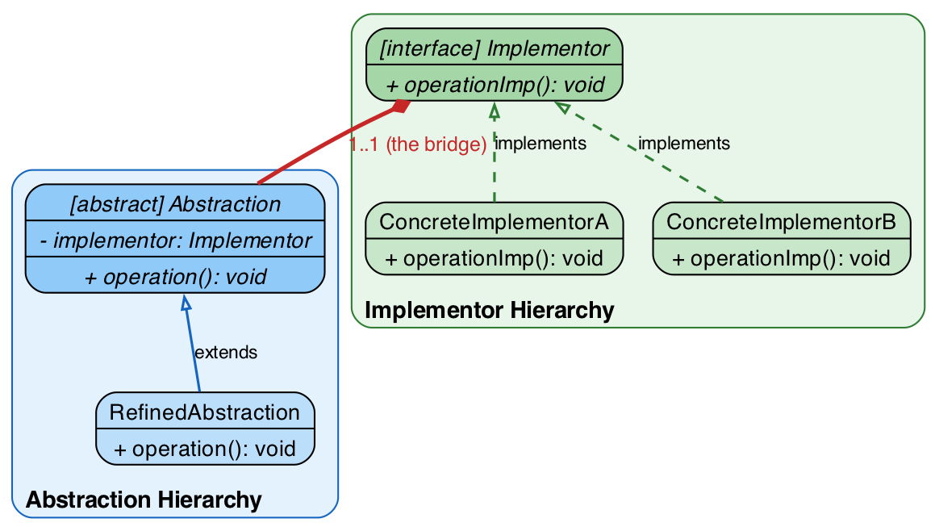
Bridge – Class Diagram
Notes:
A problem can always be fixed with another level of indirection

Slide 17
Universal Remote Control – Bridge – The Interfaces and The Abstracts
public abstract class RemoteControl {
protected Device device; // ← THE BRIDGE
public RemoteControl(Device device) {
this.device = device;
}
public void togglePower() {
if (device.isEnabled()) {
device.disable();
} else {
device.enable();
}
}
public void volumeDown() {
device.setVolume(device.getVolume() - 10);
}
public void volumeUp() {
device.setVolume(device.getVolume() + 10);
}
public void channelDown() {
device.setChannel(device.getChannel() - 1);
}
public void channelUp() {
device.setChannel(device.getChannel() + 1);
}
public void status() {
device.printStatus();
}
}
public interface Device {
boolean isEnabled();
void enable();
void disable();
int getVolume();
void setVolume(int percent);
int getChannel();
void setChannel(int channel);
void printStatus();
}
Notes:
A problem can always be fixed with another level of indirection

Slide 18
Universal Remote Control – Bridge – The Device hierarchy
public class TV implements Device {
private boolean on = false;
private int volume = 30;
private int channel = 1;
@Override public boolean isEnabled() { return on; }
@Override
public void enable() {
on = true;
System.out.println(" [TV] Powered ON.");
}
@Override
public void disable() {
on = false;
System.out.println(" [TV] Powered OFF.");
}
@Override public int getVolume() { return volume; }
@Override
public void setVolume(int percent) {
volume = Math.min(100, Math.max(0, percent));
System.out.println(" [TV] Volume → " + volume);
}
@Override public int getChannel() { return channel; }
@Override
public void setChannel(int ch) {
channel = ch;
System.out.println(" [TV] Channel → " + channel);
}
@Override
public void printStatus() {
System.out.printf(" [TV STATUS] Power=%-3s | Volume=%3d | Channel=%d%n",
on ? "ON" : "OFF", volume, channel);
}
}
public class Radio implements Device {
private boolean on = false;
private int volume = 20;
private int channel = 88; // FM frequency as integer
@Override public boolean isEnabled() { return on; }
@Override
public void enable() {
on = true;
System.out.println(" [Radio] Powered ON.");
}
@Override
public void disable() {
on = false;
System.out.println(" [Radio] Powered OFF.");
}
@Override public int getVolume() { return volume; }
@Override
public void setVolume(int percent) {
volume = Math.min(100, Math.max(0, percent));
System.out.println(" [Radio] Volume → " + volume);
}
@Override public int getChannel() { return channel; }
@Override
public void setChannel(int ch) {
channel = ch;
System.out.println(" [Radio] Frequency → " + channel + " FM");
}
@Override
public void printStatus() {
System.out.printf(" [Radio STATUS] Power=%-3s | Volume=%3d | Freq=%d FM%n",
on ? "ON" : "OFF", volume, channel);
}
}
Notes:
A problem can always be fixed with another level of indirection

Slide 19
Universal Remote Control – Bridge – The Remote hierarchy
public class AdvancedRemote extends RemoteControl {
public AdvancedRemote(Device device) {
super(device);
}
public void mute() {
System.out.println(" [ADVANCED REMOTE] Muting device.");
device.setVolume(0);
}
public void setFavoriteChannel(int channel) {
System.out.println(" [ADVANCED REMOTE] Jumping to favorite channel: " + channel);
device.setChannel(channel);
}
}
Notes:
A problem can always be fixed with another level of indirection

Slide 20
Universal Remote Control – Bridge – Application
public class Main {
public static void main(String[] args) {
// ── Basic Remote controlling a TV ──────────────────────────────────
System.out.println("=== Basic Remote + TV ===");
RemoteControl basicTV = new AdvancedRemote(new TV());
basicTV.togglePower(); // ON
basicTV.volumeUp();
basicTV.volumeUp();
basicTV.channelUp();
basicTV.channelUp();
basicTV.channelUp();
basicTV.status();
basicTV.togglePower(); // OFF
basicTV.status();
System.out.println();
// ── Advanced Remote controlling a Radio ───────────────────────────
System.out.println("=== Advanced Remote + Radio ===");
AdvancedRemote advancedRadio = new AdvancedRemote(new Radio());
advancedRadio.togglePower(); // ON
advancedRadio.volumeUp();
advancedRadio.setFavoriteChannel(101);
advancedRadio.mute();
advancedRadio.status();
System.out.println();
// ── Runtime bridge swap: same remote, different device ─────────────
System.out.println("=== Advanced Remote + TV (same remote instance, new device) ===");
AdvancedRemote smartRemote = new AdvancedRemote(new TV());
smartRemote.togglePower();
smartRemote.setFavoriteChannel(5);
smartRemote.volumeUp();
smartRemote.volumeUp();
smartRemote.volumeUp();
smartRemote.status();
}
}
Notes:
A problem can always be fixed with another level of indirection

Slide 21
Bridge – Database storage

Slide 22
Bridge – Pro and Cons
Advantages:
Independent variation: the abstraction and implementation hierarchies can evolve independently. Adding a new shape does not require new rendering code, and vice versa.
Run-time flexibility: the implementation can be swapped at run-time via the bridge reference (constructor injection or setter). This is impossible with pure inheritance.
Reduced class explosion: instead of m × n concrete classes, you have m + n. For 5 abstractions and 4 implementations: 9 classes instead of 20.
Encapsulation: implementation details are completely hidden behind the Implementor interface. Clients only see the Abstraction.
Open/Closed Principle: new implementations can be added without modifying existing Abstraction code. The system is open for extension but closed for modification.
Disadvantages:
Increased complexity: the pattern introduces an extra layer of indirection. For simple cases with one implementation, it is over-engineering.
Performance overhead: each call through the Abstraction involves a delegation step (a virtual method call on the Implementor reference). In performance-critical code this can matter, though in practice it is negligible.
Learning curve: developers must understand that there are two independent hierarchies and how they interact. The pattern is less intuitive than simple inheritance.

Slide 23
Facade
When we use it:
To provide a simple interface to a complex subsystem
To decouple a subsystem from clients and other subsystems
To layer your subsystems
Advantages:
Shields clients from subsystem components, reducing the number of objects clients must deal with.
Promotes weak coupling between subsystems and clients.

Slide 24
Composite - Problem
Many real-world domains are naturally hierarchical, part–whole structures:
A file system: directories contain files and subdirectories, recursively.
A GUI: panels contain buttons, labels, and other panels, recursively.
An organization: departments contain employees and sub-departments, recursively.
A document: a document contains paragraphs, which contain words; a table contains cells containing text …
Without the pattern, the client must constantly distinguish between "simple" objects (file, button, employee) and "container" objects (directory, panel, department): it needs if (isDirectory) checks, separate traversal code for each level, separate aggregation logic (e.g., computing a total size or total payroll requires different code per type).
This produces:
Client code coupled to concrete types — every new kind of object forces client changes.
Duplicated traversal/aggregation logic at every level of the hierarchy.
Inability to add new kinds of parts without touching existing code (violates Open/Closed).

Slide 25
Composite - Usage
When we use it
To represent part-while hierarchies of objects
You want clients to ignore the difference between composition of objects and individual objects, they will treat all objects in the composite structure uniformly
When not to use it
The hierarchy is flat or shallow with almost no composites (a plain interface + polymorphism suffices)
You need to restrict which types can be children of which containers
The "whole" has fundamentally different responsibilities than the "parts" (consider a different structural pattern, e.g., Decorator or Bridge).

Slide 26
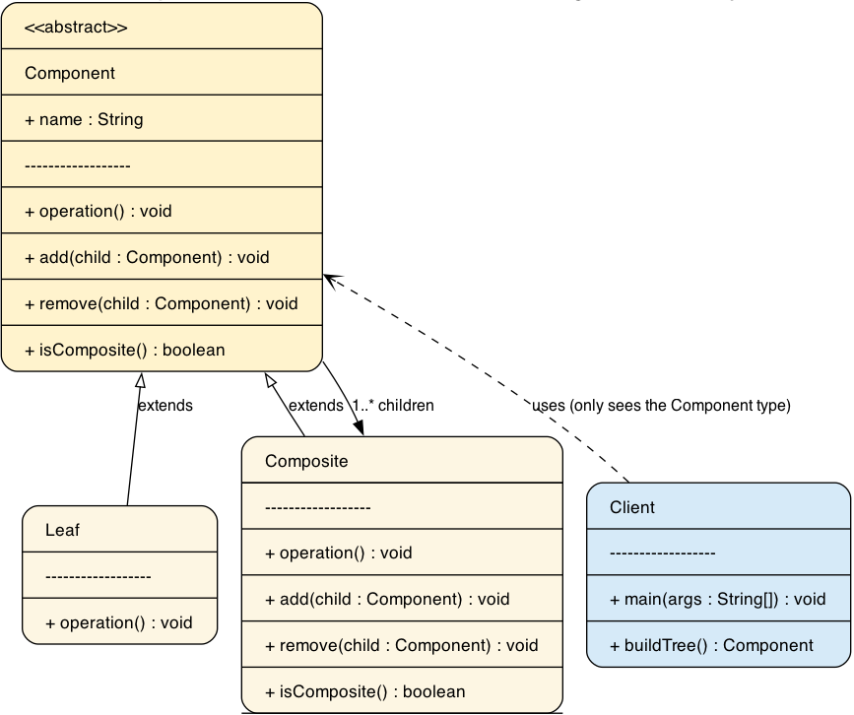
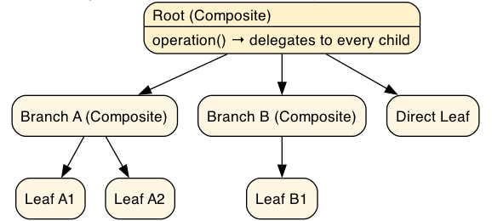
Composite – Class diagram

Slide 27
OrgChart – Composite – Interface and Leaf
public class Employee extends CompanyItem {
private final long salary;
public Employee(String name, String role, long salary) {
super(name, role);
this.salary = salary;
}
@Override
public long getSalary() {
return salary;
}
@Override
public void display(String indent) {
System.out.println(indent + "- " + name + " (" + role + ") — $" + salary);
}
/** Adds a member. Only departments support this. */
public void addItem(Item p) {
throw new UnsupportedOperationException("Cannot add people to " + name);
}
/** Removes a member. Only departments support this. */
public void addItem(Item p) {
throw new UnsupportedOperationException("Cannot remove people from " + name);
}
}
public interface Item {
public long getSalary();
public void display(String indent);
public void addItem(Item p);
public void removeItem(Item p)
}
public abstract class CompanyItem implements Item {
protected final String name;
protected final String role;
public Person(String name, String role) {
this.name = name;
this.role = role;
}
public abstract long getSalary();
public abstract void display(String indent);
public abstract void addItem(Item p);
public abstract void removeItem(Item p);
}
LEAF

Slide 28
OrgChart – Composite – The Composite
public class Department extends CompanyItem {
private final List<Item> members = new ArrayList<>();
public Department(String name, String role) {
super(name, role);
}
@Override
public long getSalary() {
long total = 0;
for (Item member : members) {
total += member.getSalary(); // recursion: employees and sub-departments alike
}
return total;
}
@Override
public void display(String indent) {
System.out.println(indent + "[" + name + " — " + role + "]");
for (Item member : members) {
member.display(indent + " "); // delegation to every member
}
}
@Override
public void addItem(Item p) {
members.add(p);
}
@Override
public void removeItem(Item p) {
members.remove(p);
}
}

Slide 29
OrgChart – Composite – Application
public class Client {
public static void main(String[] args) {
// The client only deals with Item references
Department company = new Department("Acme Corp", "Company");
Department engineering = new Department("Engineering", "Department");
engineering.addItem(new Employee("Alice", "Developer", 80_000));
engineering.addItem(new Employee("Bob", "Developer", 75_000));
Department research = new Department(“Research”, ”Department”);
research.addItem(new Employee(“Einstein”, “Scientist”, 100_000);
engineering.addItem(research);
Department sales = new Department("Sales", "Department");
sales.addItem(new Employee("Carol", "Sales Rep", 55_000));
company.addItem(engineering);
company.addItem(sales);
company.addItem(new Employee("Dave", "CEO", 200_000));
System.out.println("=== Example 3: Organization Chart ===");
System.out.println();
company.display("");
System.out.println();
System.out.println("Total payroll of Acme Corp: $" + company.getSalary());
}
}

Slide 30
Composite – GUI

Slide 31
Composite – Pro and Cons
Advantages:
Simplicity for the client: the client works with one type; it does not need to know the classes or structure of individual objects, nor how to operate on them differently
Open/Closed: new kinds of leaves (or even new composites) can be added without modifying existing client code — they just implement/extend Component
Flexibility in composition: clients can build arbitrary tree structures at runtime; the depth and shape are not fixed at compile time
Uniform operations: a single operation call applies to objects of all levels (traversal, rendering, aggregation, serialization…)
Disadvantages:
Design can become overly general: if most objects in your domain are leaves, forcing them through the Component abstraction adds indirection for little benefit. Use Composite only when you genuinely have a part–whole hierarchy.
Restriction on the types of components: if you want to restrict a container to hold only certain kinds of children (e.g., "a sentence contains only words"), it is hard with a pure Component interface — you'd need type checks or a more specific child type, which weakens the pattern's uniformity.
Traversing a complex structure can be expensive: deep recursion over large trees has time and stack cost; aggregation operations re-walk the tree on every call (no caching by default).
Leaves and composites must share a meaningful common interface: if their behaviors diverge too much, Component becomes an awkward "least common denominator."

Slide 32
Decorator - Problem
Suppose an object must support n independent, optional responsibilities (e.g., coffee toppings: mocha, whip, caramel; or text styles: bold, italic, underline).
With static inheritance, every combination requires its own subclass: with just two toppings you already need Espresso, MochaEspresso, WhipEspresso, MochaWhipEspresso … the number of classes grows exponentially (2ⁿ) and any new responsibility multiplies the explosion again.

Slide 33
Decorator - Usage
When to use it
You need to extend the behaviour of an individual object without affecting other objects of the same class
You must support extensions that can be revoked or recombined at run time (configurable pipelines, plugins, options)
Subclassing would cause a proliferation of classes for independent, orthogonal responsibilities
The object to be extended is not easily subclassable (e.g., final classes, objects from third-party libraries — you can still wrap them as long as they expose an interface)

Slide 34
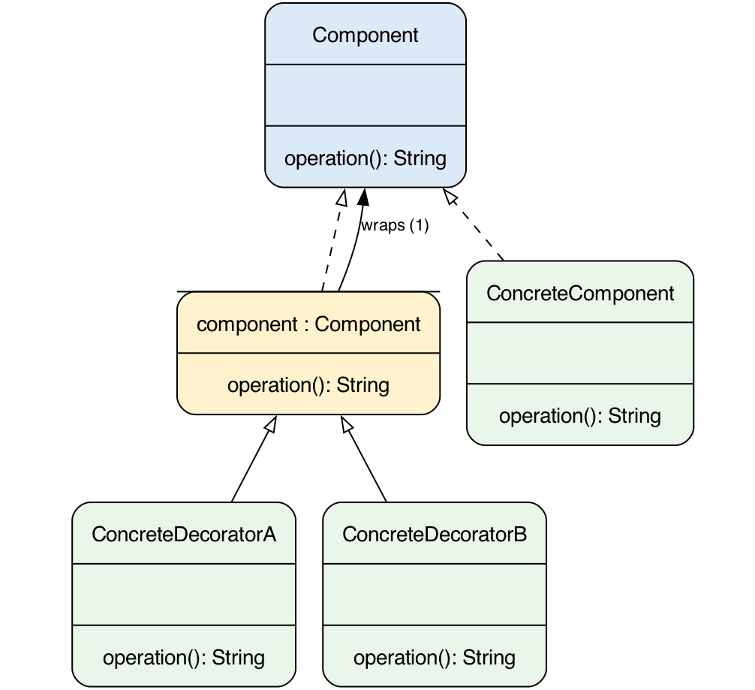
Decorator – Class diagram

Slide 35
Coffee - Decorator – Component
public interface Coffee {
String getDescription();
double getCost();
}
public class Espresso implements Coffee {
@Override public String getDescription() { return "Espresso"; }
@Override public double getCost() { return 1.99; }
}
public class HouseBlend implements Coffee {
@Override public String getDescription() { return "House Blend"; }
@Override public double getCost() { return 0.89; }
}
public class DarkRoast implements Coffee {
@Override public String getDescription() { return "Dark Roast"; }
@Override public double getCost() { return 0.99; }
}
Notes:
Watch out for the parent reference!

Slide 36
Coffee - Decorator – The Decorators
public class Milk extends CoffeeDecorator {
public Milk(Coffee coffee) { super(coffee); }
@Override
public String getDescription() {
return coffee.getDescription() + ", Milk"; }
@Override
public double getCost() { return coffee.getCost() + 0.25; }
}
public abstract class CoffeeDecorator implements Coffee {
protected final Coffee coffee; // the wrapped component
public CoffeeDecorator(Coffee coffee) {
this.coffee = coffee;
}
// Default: delegate to the wrapped object unchanged.
// Concrete decorators override only what they extend.
@Override
public String getDescription() { return coffee.getDescription(); }
@Override
public double getCost() { return coffee.getCost(); }
}
public class Mocha extends CoffeeDecorator {
public Mocha(Coffee coffee) { super(coffee); }
@Override
public String getDescription() {
return coffee.getDescription() + ", Mocha"; }
@Override
public double getCost() { return coffee.getCost() + 0.20; }
}
public class Whip extends CoffeeDecorator {
public Whip(Coffee coffee) { super(coffee); }
@Override
public String getDescription() {
return coffee.getDescription() + ", Whip"; }
@Override
public double getCost() { return coffee.getCost() + 0.30; }
}
Notes:
Watch out for the parent reference!

Slide 37
Coffee - Decorator – Application
public class Main {
public static void main(String[] args) {
System.out.println("=== Coffee Orders ===");
System.out.printf("%-50s %s%n", "Description", "Cost");
System.out.println("-".repeat(62));
// Plain base coffees
printOrder(new Espresso());
printOrder(new HouseBlend());
printOrder(new DarkRoast());
System.out.println();
// Single condiment
printOrder(new Milk(new Espresso()));
printOrder(new Mocha(new DarkRoast()));
System.out.println();
// Multiple condiments
printOrder(new Whip(new Mocha(new Milk(new Espresso()))));
printOrder(new Caramel(new Whip(new Soy(new HouseBlend()))));
System.out.println();
// Double condiment — impossible with inheritance, trivial with Decorator
printOrder(new Mocha(new Mocha(new Espresso())));
printOrder(new Milk(new Milk(new Milk(new DarkRoast()))));
System.out.println();
………
…………
// Full custom order
Coffee customOrder = new Caramel(
new Whip(
new Milk(
new Mocha(
new Mocha(
new Espresso())))));
printOrder(customOrder);
System.out.println("\nFinal order description: " +
customOrder.getDescription());
System.out.printf("Final order cost: $%.2f%n",
customOrder.getCost());
}
private static void printOrder(Coffee coffee) {
System.out.printf("%-50s $%.2f%n",
coffee.getDescription(), coffee.getCost());
}
}
Notes:
Watch out for the parent reference!

Slide 38
Decorator – Text style

Slide 39
Decorator – Pro and Cons
Advantages:
Decorators and subclasses are interchangeable for adding behaviour: decorators win on flexibility (run-time, per-object, revocable)
Avoids the subclass explosion: n responsibilities ⇒ n + 1 classes instead of up to 2ⁿ.
Each decorator has a single responsibility: they can be developed, tested and reused independently.
New behaviour can be added without modifying existing code (OCP).
Disadvantages:
Many small objects: a heavily decorated chain is a long object graph — more memory, more indirection, harder to debug ("who is actually doing this?"). The sequence diagram is the tool to reason about it.
Decoration order can change semantics: the pattern does not enforce any ordering, so the API design must make sensible compositions obvious (or guard against nonsense combinations).
Layering problems: if decorators need to access each other's internals or state, the clean delegation breaks down — a sign the responsibilities are not truly independent.
The client code is type-safe only up to the Component interface: accessing decorator-specific features requires casts, which erodes transparency.

Slide 40
Flyweight - Problem
Imagine a text editor rendering a document of 10,000 characters.
A naïve design creates one Character object per cell, each storing its glyph image, font metrics, color and position.
Most of that data (the glyph for 'e', say) is identical across hundreds of cells — yet it is duplicated in memory thousands of times.
The same problem appears in:
2D/3D rendering — a forest with 50,000 trees, a chess board, a map with many markers.
Games — thousands of bullets, particles or sprites of the same type.
Compilers / interpreters — repeated symbols, operators, AST node types.

Slide 41
Flyweight - Usage
When to use it
You have a very large number of similar objects.
A substantial part of their state can be made intrinsic (shared).
The remaining state can be moved outside and passed at call time.
Memory is the bottleneck (rendering, games, big data structures).
When not to use it
Object counts are small (the overhead isn't worth it).
State is mostly unique per object (little to share).
Intrinsic state would need to change over time.

Slide 42
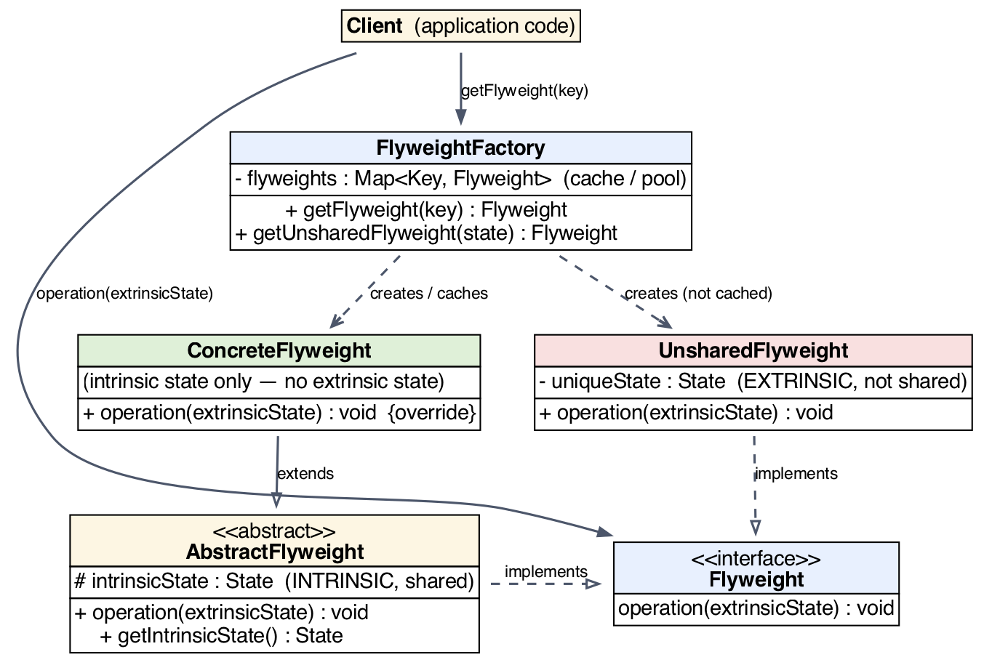
Flyweight – Class diagram

Slide 43
Forest - Flyweight – Intrinsic state
public final class TreeType {
// ── Identity fields — the basis for equals() and hashCode() ───────────
private final String name; // "Oak" | "Pine" | "Birch" | "Maple" | "Willow"
private final String color; // "Dark Green" | "Bright Green" | etc.
// ── Derived field — excluded from equals() ────────────────────────────
// Texture is a direct consequence of name+color.
// Two TreeType objects with the same name+color are the same species
// regardless of which texture file path was passed in.
private final String texture;
public TreeType(String name, String color, String texture) {
this.name = name;
this.color = color;
this.texture = texture;
System.out.printf(" [FACTORY] Loading %-30s name=%-8s color=%s%n",
"\"" + texture + "\"", name, color);
}
// ── Operation: extrinsic state passed as parameters ───────────────────
public void draw(int x, int y, int age) {
System.out.printf(" %-8s | color=%-12s | texture=%-28s | pos=(%4d,%4d) | age=%3d%n",
name, color, texture, x, y, age);
}
// ── equals() on name + color — texture is intentionally excluded ──────
@Override
public boolean equals(Object obj) {
if (this == obj) return true;
if (!(obj instanceof TreeType)) return false;
TreeType o = (TreeType) obj;
return Objects.equals(name, o.name)
&& Objects.equals(color, o.color);
}
@Override
public int hashCode() {
return Objects.hash(name, color);
}
@Override
public String toString() {
return String.format("TreeType{%-8s %-12s '%s'}", name, color, texture);
}
}

Slide 44
Forest - Flyweight – Intrinsic state factory
public class TreeTypeFactory {
// Key IS a TreeType — equals() on name+color drives all lookups.
// texture is derived here so callers only need to pass name+color.
private final Map<TreeType, TreeType> pool = new HashMap<>();
public TreeType getTreeType(String name, String color) {
// Derive texture from the two identity fields
String texture = name.toLowerCase().replace(" ", "_")
+ "_"
+ color.toLowerCase().replace(" ", "_")
+ ".png";
TreeType candidate = new TreeType(name, color, texture);
// computeIfAbsent:
// → candidate.hashCode() locates the bucket
// → candidate.equals(key) checks for a match on name+color
// → FOUND → returns existing flyweight (candidate discarded)
// → NOT FOUND → stores candidate as the new flyweight
return pool.computeIfAbsent(candidate, t -> t);
}
public int getPoolSize() { return pool.size(); }
public void printPool() {
System.out.printf(" Pool: %d unique TreeType(s)%n", pool.size());
pool.values().forEach(t -> System.out.println(" " + t));
}
}

Slide 45
Forest - Flyweight – Context (with extrinsic state)
public class Tree {
private final int x; // extrinsic
private final int y; // extrinsic
private final int age; // extrinsic
private final TreeType type; // reference to shared flyweight
public Tree(int x, int y, int age, TreeType type) {
this.x = x;
this.y = y;
this.age = age;
this.type = type;
}
public void draw() {
type.draw(x, y, age); // extrinsic state delegated to flyweight
}
}
public class Forest {
private final List<Tree> trees = new ArrayList<>();
private final TreeTypeFactory factory = new TreeTypeFactory();
public void plantTree(int x, int y, int age, String name, String color) {
TreeType type = factory.getTreeType(name, color);
trees.add(new Tree(x, y, age, type));
}
public void render() {
System.out.printf(" Rendering %,d trees:%n", trees.size());
trees.forEach(Tree::draw);
}
public int getTreeCount() { return trees.size(); }
public int getTreeTypeCount() { return factory.getPoolSize(); }
public void printPool() { factory.printPool(); }
}

Slide 46
Forest - Flyweight – Application
public class Main {
private static final String[][] SPECIES = {
{ "Oak", "Dark Green" },
{ "Pine", "Bright Green" },
{ "Birch", "White" },
{ "Maple", "Orange" },
{ "Willow", "Pale Green" }
};
public static void main(String[] args) {
Random rand = new Random(42);
// Plant 10,000 trees ────────────────────────────────────
Forest forest = new Forest();
for (int i = 0; i < 10_000; i++) {
String[] species = SPECIES[rand.nextInt(SPECIES.length)];
forest.plantTree(
rand.nextInt(5000),
rand.nextInt(5000),
rand.nextInt(200),
species[0],
species[1]
);
}
forest.render(); // prints all, truncated in output below
forest.printPool();
System.out.printf("%nTrees planted : %,d%n", forest.getTreeCount());
System.out.printf("Unique TreeTypes : %d ← only 5, regardless of tree count%n",
forest.getTreeTypeCount());
}
}

Slide 47
Flyweight – Chess

Slide 48
Flyweight – Pro and Cons
Advantages:
Dramatic memory reduction when many similar objects exist.
Lower allocation / GC pressure — fewer live objects.
Centralized sharing policy in the factory; clients stay simple.
Disadvantages:
Complexity: adds a factory + cache and forces you to split state, which is not always obvious up front.
Indirection & CPU cost: passing extrinsic state and looking up the cache adds a little overhead per operation.
Intrinsic state must be immutable: if it changes, sharing breaks.
Only worthwhile when the number of objects is large AND they are highly repetitive.

Slide 49
Proxy - Problem
A client sometimes needs to work with an object that is:
expensive to create — a large image, a big dataset, a database connection pool;
sensitive — access must be authorized (permissions, roles, credentials);
located elsewhere — on another machine, in another address space.
Creating such objects eagerly, or letting clients touch them directly, causes wasted resources, security holes, or tight coupling to infrastructure details.
The client should instead work with a simple stand-in that looks exactly like the real object and decides when, how, and whether access actually happens.

Slide 50
Proxy - Usage
When to use it
object creation is expensive and may never be needed (virtual, lazy instantiation);
access must be controlled by permissions or credentials (protective);
the object lives in another address space and should look local (remote);
you want to add cross-cutting behavior (caching, logging) without modifying the real subject
When not to use it
you need many different behaviors that can be combined at runtime → Decorator;
the extra indirection layer is unacceptable in a hot path (every call pays the overhead);
the object is cheap, local, and has no access concerns — a proxy would only add complexity.

Slide 51
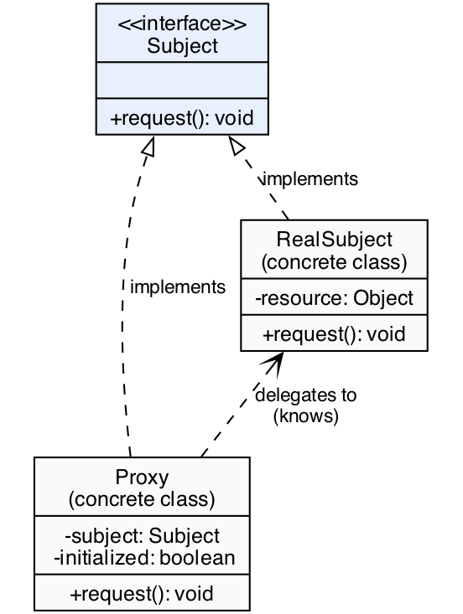
Proxy – Class diagram

Slide 52
DataService - Proxy – The Subject
public interface DataService {
String fetchData(String query);
void saveData(String key, String value);
void deleteData(String key);
}
public class DatabaseService implements DataService {
public DatabaseService() {
// Simulates an expensive startup: connection pool, schema validation, etc.
System.out.println(" [DB] Initialising connection pool............. done");
System.out.println(" [DB] Loading schema cache..................... done");
System.out.println(" [DB] Running startup health check............. done");
}
@Override
public String fetchData(String query) {
System.out.println(" [DB] SELECT * WHERE key = '" + query + "'");
return "{ \"result\": \"data_for_" + query + "\" }";
}
@Override
public void saveData(String key, String value) {
System.out.println(" [DB] INSERT/UPDATE key='" + key + "' value='" + value + "'");
}
@Override
public void deleteData(String key) {
System.out.println(" [DB] DELETE WHERE key='" + key + "'");
}
}

Slide 53
DataService - Proxy – Cache Proxy
public class CachingProxy implements DataService {
private final DataService service;
private final Map<String, String> cache = new HashMap<>();
public CachingProxy(DataService service) {
this.service = service;
}
@Override
public String fetchData(String query) {
if (cache.containsKey(query)) {
System.out.println(" [CACHE] HIT → '" + query + "'");
return cache.get(query);
}
System.out.println(" [CACHE] MISS → '" + query + "' — delegating to real service");
String result = service.fetchData(query);
cache.put(query, result);
System.out.println(" [CACHE] Stored result for '" + query + "'");
return result;
}
@Override
public void saveData(String key, String value) {
cache.remove(key); // write-through: invalidate stale entry
System.out.println(" [CACHE] Invalidated '" + key + "'");
service.saveData(key, value);
}
@Override
public void deleteData(String key) {
cache.remove(key);
System.out.println(" [CACHE] Invalidated '" + key + "'");
service.deleteData(key);
}
}

Slide 54
DataService - Proxy – Protection Proxy
public class ProtectionProxy implements DataService {
private final DataService service;
private final String role; // "READONLY" | "USER" | "ADMIN"
public ProtectionProxy(DataService service, String role) {
this.service = service;
this.role = role;
}
@Override
public String fetchData(String query) {
// All roles may read
System.out.println(" [PROTECTION] role=" + role + " → fetchData ALLOWED");
return service.fetchData(query);
}
@Override
public void saveData(String key, String value) {
require("USER", "ADMIN");
System.out.println(" [PROTECTION] role=" + role + " → saveData ALLOWED");
service.saveData(key, value);
}
@Override
public void deleteData(String key) {
require("ADMIN");
System.out.println(" [PROTECTION] role=" + role + " → deleteData ALLOWED");
service.deleteData(key);
}
// Throws if the caller's role is not in the allowed list
private void require(String... allowedRoles) {
for (String allowed : allowedRoles) {
if (role.equals(allowed)) return;
}
throw new SecurityException(
" [PROTECTION] role=" + role + " → ACCESS DENIED " +
"(requires one of: " + String.join(", ", allowedRoles) + ")");
}
}

Slide 55
DataService - Proxy – Application
public class Main {
public static void main(String[] args) {
System.out.println("\n\n=== Protection Proxy ===\n");
DataService realService = new DatabaseService();
// USER can read and write, but not delete
System.out.println("\n-- User role: USER --");
DataService userProxy = new ProtectionProxy(realService, "USER");
System.out.println(userProxy.fetchData("user-2"));
userProxy.saveData("user-2", "updated value"); // allowed
try {
userProxy.deleteData("user-2"); // denied
} catch (SecurityException e) {
System.out.println(e.getMessage());
}
// ADMIN has full access
System.out.println("\n-- User role: ADMIN --");
DataService adminProxy = new ProtectionProxy(realService, "ADMIN");
adminProxy.fetchData("user-3");
adminProxy.saveData("user-3", "admin update");
adminProxy.deleteData("user-3"); // allowed
System.out.println("\n\n=== Caching Proxy ===\n");
DataService cachingProxy = new CachingProxy(realService);
System.out.println("-- First fetch (cache MISS) --");
cachingProxy.fetchData("report-Q3");
System.out.println("\n-- Second fetch (cache HIT) --");
cachingProxy.fetchData("report-Q3");
System.out.println("\n-- Third fetch, different key (cache MISS) --");
cachingProxy.fetchData("report-Q4");
System.out.println("\n-- Save invalidates cache --");
cachingProxy.saveData("report-Q3", "updated Q3 data");
System.out.println("\n-- Fetch after invalidation (cache MISS again) --");
cachingProxy.fetchData("report-Q3");
}
}

Slide 56
Proxy – Remote Calculator

Slide 57
Proxy – Pro and Cons
Advantages
Client is decoupled from creation/access details; it programs to `Subject` only.
Lazy initialization saves memory and startup time (virtual).
Security enforcement is centralized in one place, not scattered across the real object (protective).
Remote objects become transparent to the client (remote).
Cross-cutting concerns can be added in a single class without touching the real subject.
Disadvantages:
Extra indirection: small latency and memory overhead per call.
More classes → larger codebase, more names to maintain.
Debugging is harder (extra stack frames, "who created this object?").
A proxy that accumulates too many responsibilities becomes a god object.
Non-transparent proxies leak setup complexity to the client.

Slide 58
When to Use Structural Patterns
Use Adapter when integrating existing
incompatible code
Use Bridge when both abstraction and
implementation may change
Use Composite for part-whole hierarchies
and tree structures
Use Decorator for optional features without
subclass explosion
Use Facade to simplify complex interfaces
for common operations
Use Flyweight when memory usage is
critical with many similar objects
Use Proxy for controlled access, lazy loading, or caching
Benefits of Structural Patterns
Simplify Code - Organize and simplify complex relationships
Reduce Duplicate Code - Reuse existing structures efficiently
Enhance Flexibility - Add/change features without altering existing code
Improve Readability - Clear structure makes code easier to understand
Optimize Resources - Share data efficiently and reduce memory usage
Common Pitfalls
Overengineering - Using patterns unnecessarily adds complexity
Performance Overhead - Extra layers can impact performance
Maintenance Complexity - Too many patterns make code harder to debug

